Slide 1
Voices in Anime
Mihoko Teshigawara
Komazawa University, Japan
mteshi_at_komazawa-u.ac.jp

Slide 2
Background (1/4): Studies of Speech Sounds
Information | Analysis Techniques | Unit of Analysis
Linguistic info Paralinguistic info Attitudes Extralinguistic info Sex Age Physical characteristics Personality (impressions) etc. | Acoustic / experimental phonetics analysis Articulatory / Physiological analysis Auditory analysis Perceptual experiment | Segments Supra-segmentals

Slide 3
Background (2/4): How I Started My Research of Voices in Anime
Developed interests in
The impressions of personality and other attributes the speaker gives via speech and the phonetic correlates of such impressions
The origin of relationships between the impressions and the phonetic characteristics
Anime voices can be good materials for studying these relationships and their origins

Slide 4
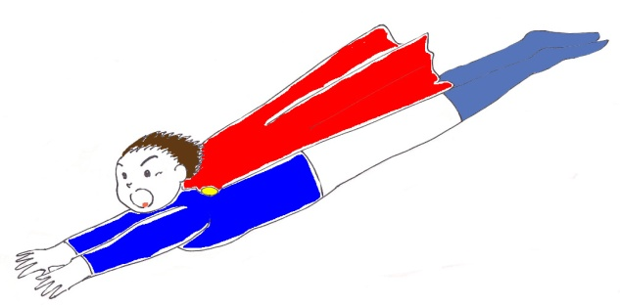
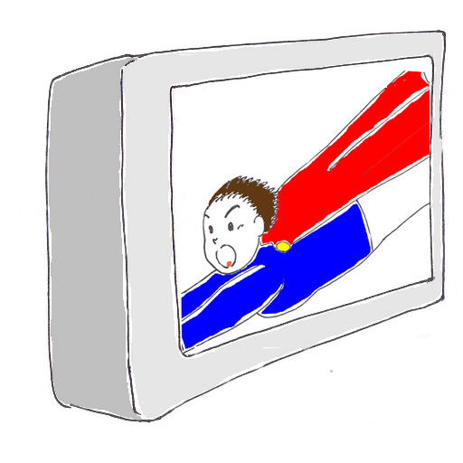
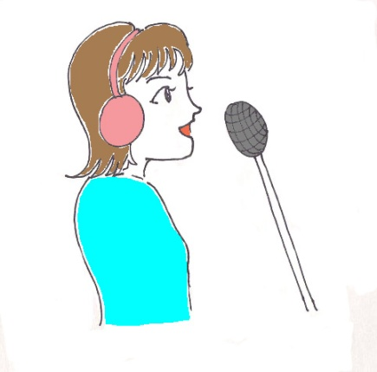
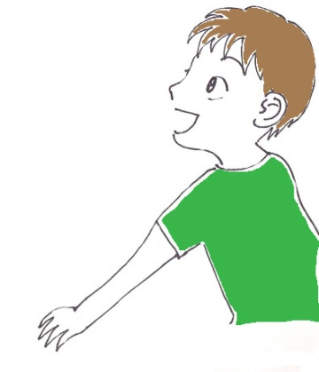
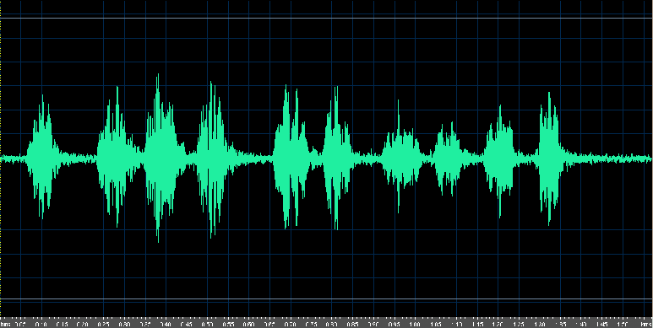
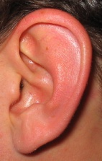
Background (3/4): Anime voice studies (1/2)
Visual image
Cartoon character
I’m going to rescue you now!
Cool!
I’m going to rescue you now!
Perception
Voice
Physiological observation
Acoustic analysis
Auditory analysis

Slide 5
Background (4/4): Anime voice studies (2/2)
Teshigawara (2003, 2009): Auditory and acoustic analyses of 88 anime voices; perceptual experiment using 27 random-spliced voices with Japanese listeners
Teshigawara et al. (2007, 2009): Perceptual experiment using the same set of random-spliced voices and original voices with Hebrew listeners
Teshigawara and Murano (2004): MRI study of a subject uttering 5 voice types

Slide 6
Materials
Anime voices from 20 titles (1960’s– 1990’s) with clear distinction between heroes and villains
Objective: To abstract characteristics of voices of stereotypical good guys and bad guys
A total of 88 character voices
Breakdown: voices of heroes, villains, and villainous-sounding supporting roles
Characters with clean voice portions (= without sound effects or background music )

Slide 7
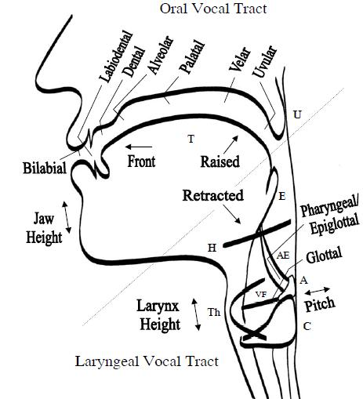
Auditory Analysis (1/4): Method
Deduction of articulatory characteristics based on introspection
Laryngeal settings
Supralaryngeal settings
Laver’s (1994) descriptive framework for voice quality with some modifications
Addition of “supraglottic states” (laryngeal constriction vs. larynx lowering) to Laver
Deviations from the neutral setting were recorded using scalar degrees
Esling (2005)

Slide 8
Auditory Analysis (2/4): Sample Vocal Profile Protocol
Category | Setting | Scalar degrees
 |  | neutral | non neutral
Phonatory | modal voice
 | falsetto
 |  |  | 1 | 2 | 3
 | creak(y)
 | whisper(y)
 | harsh
 | breathy

Slide 9
Auditory Analysis (3/4): Results (1/2)
Auditorily identified 4 Voice Types
Hero Type I: no laryngeal constriction with/without breathy voice
Hero Type I' (among characters played by female voice actors): moderately breathy voice
Hero Type II: slight or intermittent laryngeal constriction
Villain Type I: moderate or extreme laryngeal constriction, raised larynx, jaw protrusion, labial constriction, close jaw and harsh voice
Villain Type II: lowered larynx, with/without slight jaw protrusion and slight labial constriction

Slide 10
Auditory Analysis (4/4): Results (2/2)
Characteristics of Villain Type I voices coincide with those expressing negative emotions (Scherer, 1986)
Pharyngeal expansion (=larynx lowering) in Villain Type II voices might be comparable to that in wayang (puppet) voices expressing negative emotions (Poedjosoedarmo, 1986)
Vocal stereotypes of bad characters might have something to do with vocal expressions of negative emotions

Slide 11
Acoustic Analysis (1/3): Methods
Pitch: Measuring fundamental frequency (F0) for stretch of speech for each speaker
Mean F0 = overall tendency of pitch height
Standard Deviation of F0 = pitch range
Vowels: Measuring first two vowel formant frequencies (F1 and F2) of vowels /a, i, o/ for each speaker
Mean F1 and F2
Spectrographic analysis
See Teshigawara (2003) for more details and results

Slide 12
Acoustic Analysis (2/3): Results (1/2)
Spectrogram of a Hero Type I voice
Spectrogram of a Hero Type II voice

Slide 13
Acoustic Analysis (3/3): Results (2/2)
Spectrogram of a Villain Type I voice

Slide 14
Perceptual Experiment (1/10): Overview (1/4)
Two separate experiments using speakers / listeners of two languages (i.e., Japanese and Hebrew)
Aims: To examine
Experiment 1: How voices of speakers exhibiting different laryngeal settings (auditorily identified) will be perceived by lay Japanese participants to be different (Teshigawara 2003 & 2009)
Experiment 2: How the same set of characters’ voices will be perceived by Hebrew participants, who come from a culture unrelated to Japanese – Are vocal stereotypes universal or culturally specific? (Teshigawara et al. 2009)

Slide 15
Perceptual Experiment (2/10): Overview (2/4)
Experiment stimuli
Voices of 27 Japanese anime characters varying in supraglottic states
Random splicing technique: content-masking technique retaining voice quality information (Scherer, 1971)
To make participants pay attention to the voice qualities rather than the verbal content

Slide 16
Perceptual Experiment (3/10): Overview (3/4)
Questionnaire
19 adjectival items on 7-point scales
2 physical traits: big, good-looking
11 personality traits: selfless, brave, etc.
1 emotional state: positive
5 vocal characteristics: high-pitched, pleasant, etc.
Task: To say what kind of character each voice actor is playing

Slide 17
Perceptual Experiment (4/10): Overview (4/4)
Participants
Experiment 1: 31 male and female Japanese students in Nagoya University
Experiment 2: 20 female Hebrew students in Tel Aviv University
Rating processing after the experiment
Objective: To extract overall perceptual tendencies in each culture rather than each individual in each cultural group
Method: z-score calculation followed by calculation of mean score for each adjectival item

Slide 18
Perceptual Experiment (5/10): Phonetic Measures
Phonetic measures provided for each voice
Auditory characteristics (scale measures)
Degree of laryngeal constriction
Degree of larynx lowering
Degree of breathiness
Acoustic measures
Fundamental frequency (F0) related
Mean F0
F0 Standard Deviation (SD)
Second formant (F2) of vowel /a/

Slide 19
Perceptual Experiment (6/10): Correlations between Adjectival Ratings and Phonetic Properties
Correlations were calculated between the processed adjectival ratings and the phonetic measures, separately for sex of voice actor (9 males; 18 females) and participant country
Correlations between the ratings and the phonetic measures coincide between the two cultures
Degree of laryngeal constriction has negative correlations with positive trait items
Degree of larynx lowering has positive correlations with “big” and “strong”

Slide 20
Correlations between Perceptual Experiment Items and Phonetic Measures (Excerpt 1)
 | Constr. (M) | Constr. (F) | Breathy (F) | Mean F0 (M) | Mean F0 (F)
Good-looking | -.93** -.82** | -.76** -.67** | .39 .61** | -.87** -.74* | .69** .52*
Loyal | -.82** -.90** | -.84** -.75** | .60** .62** | -.33 -.70* | .56* .39
Conscientious | -.69* -.90** | -.81** -.77** | .56* .61** | -.21 -.71* | .63** .40
Sympathetic | -.80** -.87** | -.82** -.80** | .60** .64** | -.56 -.66 | .58* .29
(Vocally) Pleasant | -.85** -.86** | -.76** -.66** | .60** .76** | -.86** -.80** | .47* .29
(Vocally) Attractive | -.82** -.85** | -.82** -.55* | .56* .65** | -.88** -.82** | .57* .44
J
I
J
I
J
I
J
I
J
I
J
I
The more constricted, the less good-looking, loyal, etc.
The breathier, the more good-looking, loyal, etc.
The higher the pitch, the more good-looking, loyal, etc. (J)
The higher the pitch, the less good-looking, loyal, etc. (I)

Slide 21
Correlations between Perceptual Experiment Items and Phonetic Measures (Excerpt 2)
 | Lowering (M) | Lowering (F) | /a/ F2 (M) | /a/ F2 (F)
Big | .69* .60 | .58* .32 | -.93** -.92** | -.35 -.61**
Strong | .78* .76* | .63* .12 | -.77* -.89** | -.54* -.45
J
I
J
I
The lower the larynx is, the bigger and stronger
The lower the F2, the bigger and stronger

Slide 22
Perceptual Experiment (9/10): Results (1/2)
Similarities between two cultures/languages
The higher the degree of laryngeal constriction, and the breathier the voice, the more positive the ratings
The higher the degree of larynx lowering, and the lower the F0, the bigger and stronger the characters are perceived to be
Possibility of universality across cultures
cf. Universality of vocal emotions (Scherer, 2001 et al.)

Slide 23
Perceptual Experiment (10/10): Results (2/2)
Differences between two cultures/languages
Degree of larynx lowering vs. trait items
Hebrew participants: No correlations for female voice actors
F0
Japanese participants’ ratings for female voice actors: the higher the F0, the more positive the ratings
Hebrew participants’ ratings for male voice actors: the lower the F0, the more positive the ratings
Cultural specificity

Slide 24
Speculations about Origin of Person Perception Based on Voice (1/3)
Two universal dimensions of social cognition (Fiske et al. 2007)
Warmth: “friend or foe” – perceived intent (e.g., friendliness, helpfulness, sincerity, trustworthiness and morality)
Competence: perceived ability to enact the intent (e.g., intelligence, skill, creativity, and efficacy)
Two dimensions of face evaluation (Oosterhof & Todorov 2008)
Valence: positive traits (e.g., attractive, responsive)
Dominance (with aggressiveness and confidence)

Slide 25
Speculations about Origin of Person Perception Based on Voice (2/3)
Dimensions of animal vocalizations (Morton 1977, 1994)
Motivation-Structural Rules
First dimension: Quality – harsh to pure tone-like
Second dimension: F0 and spectral energy distribution
→Developed to the Frequency Code (Ohala 1994)

Slide 26
Speculations about Origin of Person Perception Based on Voice (3/3)
Speculations about two fundamental dimensions of person perception based on voice = vocal stereotyping
Warmth / Valence: realized in laryngeal constriction
Competence / Dominance: realized in larynx lowering + F0 / formants
Future research possibilities
Identifying underlying dimensions of vocal stereotyping using synthesized voices

Slide 27
Physiological Observations (1/11): MRI Study (Teshigawara & Murano 2004) – Aims
To supplement the auditory descriptions of the heroic and villainous voice types (Teshigawara, 2003) with physiological observations.
To show how much one can alter the vocal tract in portraying different characters
Picturing positions of articulators during phonation imitating heroic and villainous voice types with an MRI.

Slide 28
Physiological Observations (2/11): MRI Study – Method
Subject: A female native speaker of Japanese
Posture: Supine
Speech task
Repetitions of vowel /i/ at 240 Hz
Adopting four hero and villain voice types and the normal setting.

Slide 29
Physiological Observations (3/11): Target Voice Quality Settings
Reference: normal setting
Voice type | Auditorily identified characteristics
Hero I | fronted tongue body, open jaw, moderately breathy voice
Hero II | slight or intermittent supraglottic constriction
Villain I | moderate or extreme supraglottic constriction, raised larynx, jaw protrusion, labial constriction, close jaw, harsh voice
Villain II | lowered larynx, slight labial constriction

Slide 30
Physiological Observations (4/11): Results – MR image of the normal setting: Lateral view
AS: anterior nasal spine
PS: posterior nasal spine
MS: mandibular symphysis
H: hyoid bone
C2 to C5: cervical spines.
1
2
5
3
4
Tracings were performed to extract the visible outlines of the vocal tract.
Notes:
Results. This is the mid-sagittal image of the normal setting. For each voice type, I performed tracings in order to extract the visible outlines of the vocal tract, hyoid bone, and a few landmarks.

Slide 31
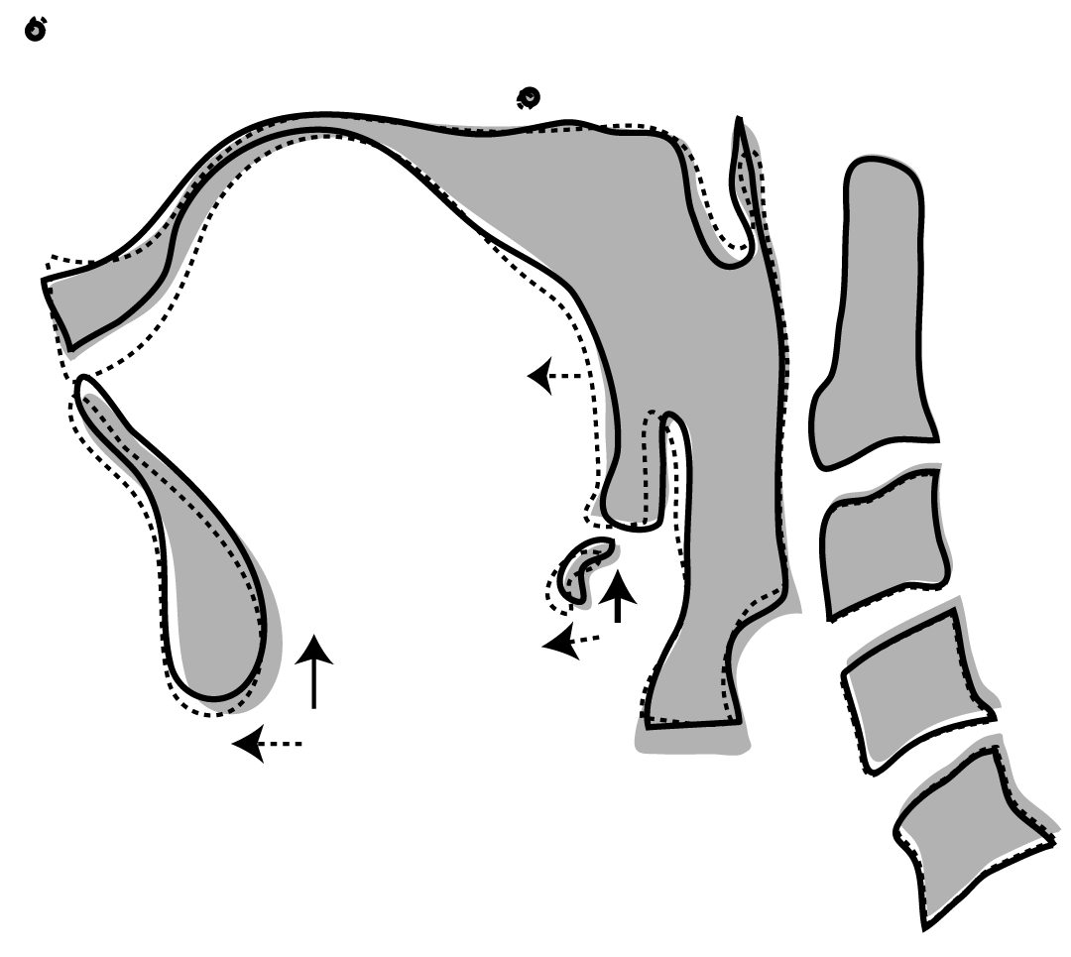
Hero Type voices: Lateral view
AS
palate
PS
Anterior
tongue
Posterior
C2
H
MS
C5
MRI tracings for Hero Types I (solid line) and II (broken line) superimposed on normal setting (gray)
Notes:
This figure compares the two Hero Type voices with the normal setting. The two voices are superimposed on the normal setting, which is gray – Hero Type I in solid line, and Hero Type II in broken line. As you can see, deviations from the normal setting are not large in these settings. The vocal tract lengths are little shorter in both voice types than the normal setting. There are some more differences in the pharyngeal area and other articulators.

Slide 32
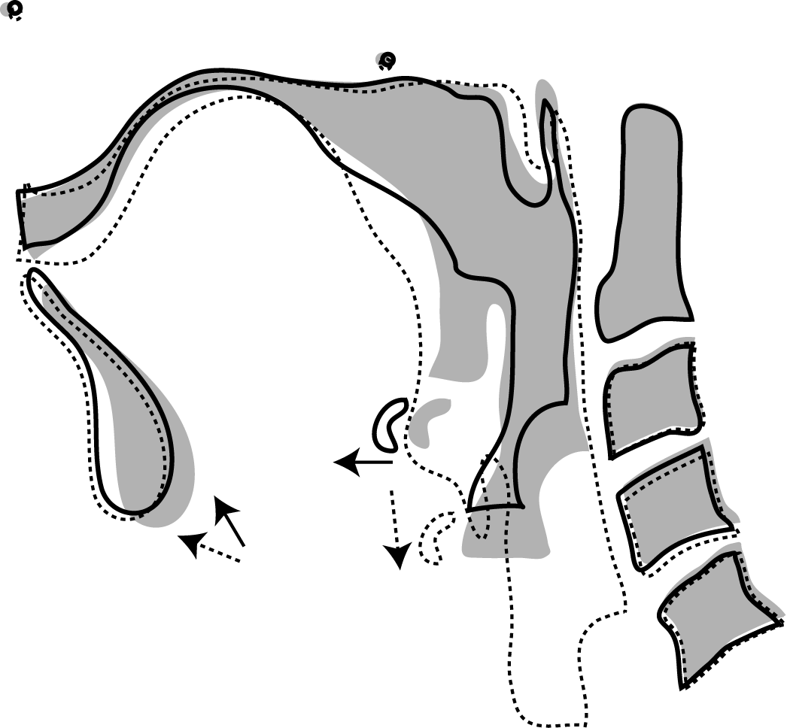
Villain Type voices: Lateral view
AS
palate
PS
Anterior
tongue
Posterior
C2
H
MS
C5
MRI tracings for Villain Types I (solid line) and II (broken line) superimposed on normal setting (gray)
Notes:
Now, turning to the villainous voices, deviations from the normal setting are much larger. Again they are superimposed on the normal setting: Villain Type I in solid line, and Villain Type II in broken line. The deviations from the normal setting are quite remarkable in both villain types and the largest deviations are in the pharyngeal and laryngeal areas. In Villain Type I, everything is squeezed upward and it’s got a narrow pharynx and small larynx tube. On the other hand, Villain Type II has an elongated vocal tract; as a result, it’s got an enlarged pharynx and larynx tube. Larynx heights differ accordingly, so do the shapes of the vallecula. The places of the hyoid bone also deviate from the normal setting quite a bit for both settings.

Slide 33
Physiological Observations (7/11): 3D reconstructed images – preliminary results: normal setting
Lateral view
8
6
Diagonal
7
4
8
5
4
5
3
Posterior view
8
3
2
1
1
2
5
1
1: Piriform sinus 2: Laryngeal tube
3: Vallecula 4: Oral cavity
5: Inter-labial space 6: Velum
7: Tongue 8: Palate
Arrow: Level of the glottis
1
2
1
Notes:
I’m going to show you these differences from a different angle using 3D images reconstructed by Emi, the second author. For those of you who have never seen such pictures, I have to tell you that they are not dinosaurs but they represent the vocal tract volume. You are going to see three different views, lateral view, diagonal view and posterior view of the five settings.

Slide 34
3D reconstructed images compared across five voice types (1/3)
Lateral view
Hero I
Hero II
Normal
Villain I
Villain II
Line: level of the glottis of the normal setting.
Lengths from the palate to the glottis:
Villain I (0.89) < Hero II (0.91) < Hero I (0.95) <
Normal (1.00) < Villain II (1.34).
Notes:
When you see the five setting from the side, the differences in the vocal tract lengths become clearer. The line was drawn at the level of the glottis of the normal setting. You can see that the shortest is Villain I, the two Hero Type voices are slightly longer than that, then normal, and Villain II is much longer than normal, which is 1.34 times as large as Normal.

Slide 35
3D reconstructed images compared across five voice types (2/3)
Diagonal view
Hero I
Hero II
Normal
Villain I
Villain II
See the differences in the shape and the size of the pharynx among the five settings.
Notes:
In the 斜め前 view, the differences in the shape and the size of the pharynx are very prominent. You can see differences in the larynx tube and the piriform sinuses as well.

Slide 36
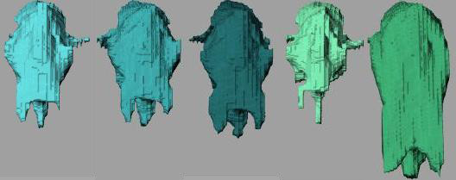
3D reconstructed images compared across five voice types (3/3)
Posterior view
Hero I
Hero II
Normal
Villain I
Villain II
Size of the piriform sinuses:
Villain I (almost nonexistent) < Hero I, II, Normal < Villain II (enlarged)
Notes:
From the back, you can the shape and the size of the piriform sinuses vary among the voice types more clearly; they are almost nonexistent in Villain Type I whereas they are enlarged very much in Villain Type II, and the rest are somewhere in the middle.

Slide 37
Physiological Observations (11/11): Conclusions
The most prominent differences between the heroic and villainous voice types lie in the pharyngeal and supraglottic areas
Observed what was not satisfactorily described in previous studies solely based on an auditory analysis by a phonetician:
vocal tract length, pharyngeal cavity, the position of the hyoid bone, piriform sinuses, etc.
MRI can complement the weaknesses of the auditory analysis.
Voice quality controls in anime are likely to involve modifications of the entire vocal tract as well as phonation types.

Slide 38
Conclusions
Anime voices can be good research materials for vocal stereotyping in the culture
Examples of phonetic research methods were introduced
Auditory analysis
Acoustic analysis
Perceptual experiment
Physiological observation

Slide 39
References (1/3)
Esling, J. H. (2005). There are no back vowels: The laryngeal articulator model. Canadian Journal of Linguistics, 50, 13-44.
Fiske, S. T., Cuddy, A. J. C., & Glick, P. (2007). Universal dimensions of social cognition: warmth and competence. TRENDS in Cognitive Sciences, 11, 77-83.
Laver, J. (1994). Principles of Phonetics. Cambridge, UK: Cambridge University Press.
Morton, E.S. (1977). On the occurrence and significance of motivation-structural rules in some bird and mammal sounds. American Naturalist, 111, 855-869.
Morton, E.S. (1994). Sound symbolism and its role in non-human vertebrate communication. In L. Hinton et al, (Eds.), Sound symbolism, pp. 348-365.
Ohala, J. J. (1994). The frequency code underlies the sound symbolic use of voice pitch. In L. Hinton et al, (Eds.), Sound symbolism, pp. 325–347, Cambridge University Press.
Oosterhof, N. N. & Todorov, A. (2008). The functional basis of face evaluation. PNAS, 105, 32, 11087–11092.

Slide 40
References (2/3)
Poedjosoedarmo, G. (1986). The symbolic significance of pharyngeal configuration in Javanese speech: Some preliminary notes. NUSA, Linguistic Studies in Indonesian and Languages in Indonesia, 25, 31-37.
Scherer, K. R. (1971). Randomized splicing: A note on a simple technique for masking speech content. Journal of Experimental Research in Personality, 5, 155–159.
Scherer, K. R. (1986). Vocal affect expression: A review and a model for future research. Psychological Bulletin 99, 143–165.
Scherer, K.R., Banse, R., & Wallbott, H. G. (2001). Emotion inferences from vocal expression correlate across languages and cultures. Journal of Cross-Cultural Psychology, 32, 76–92.
Teshigawara, M. (2003). Voices in Japanese Animation: A phonetic study of vocal stereotypes of heroes and villains in Japanese culture . PhD. Dissertation, University of Victoria, Canada. [http://web.uvic.ca/ling/assets/documents/Dissertation_ Teshigawara.pdf]

Slide 41
References (3/3)
Teshigawara, M. (2009). Vocal expressions of emotions and personalities in Japanese anime. In K. Izdebski (ed.), Emotions of the human voice, Vol. III Culture and Perception, pp. 275–287. Plural Publishing: San Diego.
Teshigawara, M., Amir, N., Amir, O., Milano Wlosko, E., Avivi M. (2007). Effects of random splicing on listeners’ perceptions. Proceedings of the ICPhS 2007, pp. 2101–4.
Teshigawara, M., Amir, N., Amir, O., Milano Wlosko, E., Avivi M. (2009) Perceptions of Japanese anime voices by Hebrew speakers. In K. Izdebski (ed.), Emotions of the human voice, Vol. III Culture and Perception, pp. 189–198. Plural Publishing: San Diego.
Teshigawara, M., Murano, E. Z. (2004). Articulatory correlates of voice qualities of good guys and bad guys in Japanese anime: an MRI study . Proceedings of INTERSPEECH 2004 (ICSLP), Vol. 2, 1249–1252.

