Slide 1
Kinetic Resolution &
Desymmetrization reaction
Jie Liu
Nov30/2016

Slide 2
Definition
Kinetic Resolution
It’s a process leading to the separation of enantiomers, or derivatives thereof.
Desymmetrization Reaction
is the modification of a molecule that result in the loss of one or more symmetry elements. Commonly, desymmetrization convert symmetry compounds into chiral products.

Slide 3
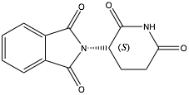
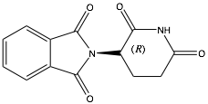
The classic racemic drug
Thalidomide
(S)-enantiomer is efficacious
and beneficial
(R)-enantiomer is toxic and causes birth
defects when give to pregnant women
Chiral compound

Slide 4
Methods to obtain a particular enantiomer
Kinetic resolution
Chiral chromatography
Use of chiral natural products as starting materials
Stoichiometric use of chiral auxiliaries
Asymmetric (desymmetrization) catalysis
L.G. Wade, Jr., Organic Chemistry, 8th ed., Pearson Education,
Inc.: UpperSaddle River, NJ, 2013, pp. 209-212

Slide 5
Kinetic Resolution
Secondary Alcohols — racemic mixture
identical physical
properties
+
Pd-catalyzed Oxidation
+
easy to separate

Slide 6
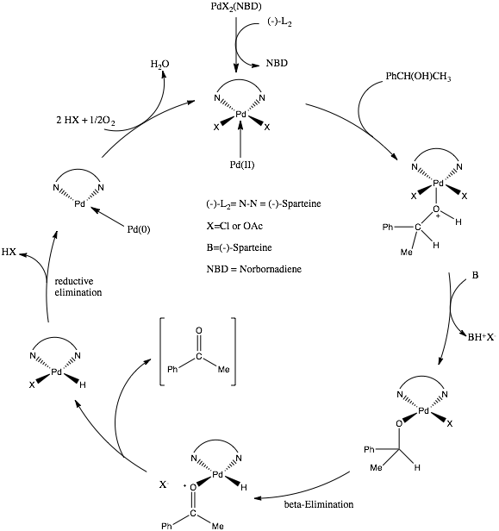
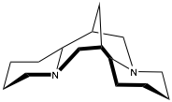
(-)-alfa-Isosparteine
M. J. Schultz, R. S. Adler,W. Zierkiewicz, T. Privalov, and M. S. Sigman, J.Am. Chem.Soc., 2005,127,8499

Slide 7
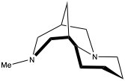
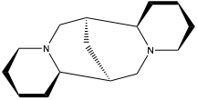
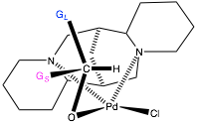
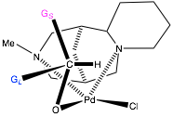
(-)-alfa-Isosparteine
analog of
(+)-sparteine
view from side
view from bottom
beta-elimination
intermediate
(S)
(R)
G. O. Spessard, G. L. Missler, 3rd ed., Oxford University Press, NY 10016, 2016, pp. 618-621

Slide 8
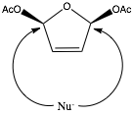
Asymmetric Desymmetrizatoin Reaction
Nu-
So, the desymmetrization itself is not usually considered useful, the enantioselective delivers a useful product.

Slide 9
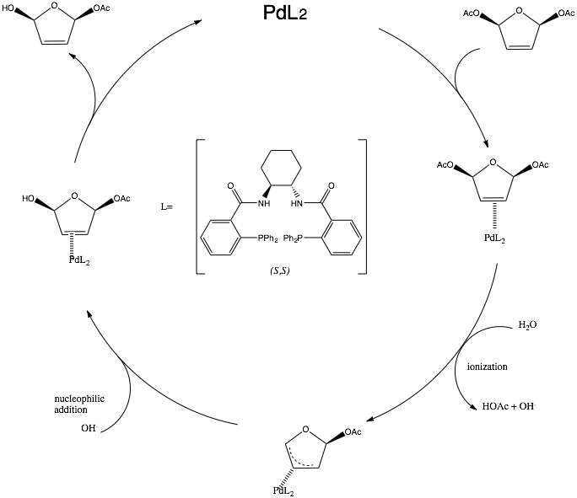
Donald R. Deardorff, Colin Q. Windham, and Chris L. Craney, Organic Syntheses, Coll. Vol. 9, p.487 (1998); Vol. 73, p.25 (1996).

Slide 10
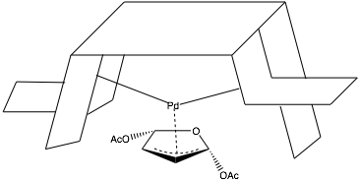
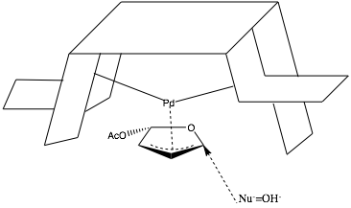

Slide 11
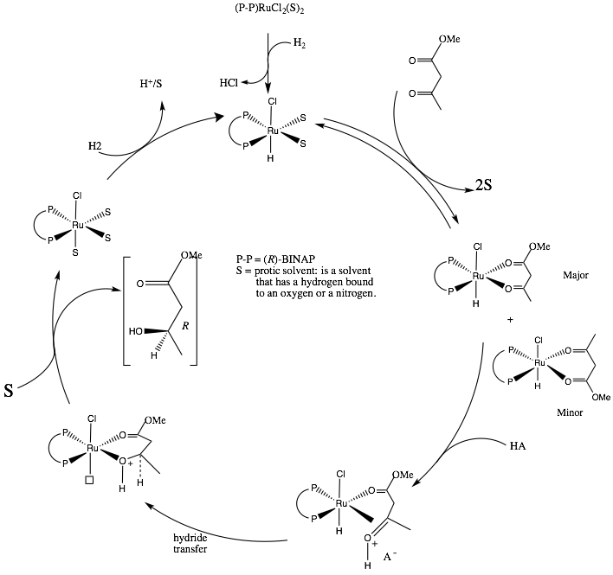
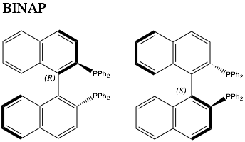
Enantioselective Reaction
H2
+
(R)
(S)
R.Noyori, M.Kitamura,and T.Ohkuma, Proc.Natl.Acad. Sci. U.S.A., 2004, 101, 5356

