Slide 1
Cu Catalyzed Cross Coupling
Darien Yeung

Slide 2
Roadmap
1) Cross-Coupling Relevance since establishment of technique
2) Examples of Cu Catalyzed Cross Coupling
3) Mechanism of Catalysis
Relevance > Examples of Cu Cross Coupling > Mechanism

Slide 3
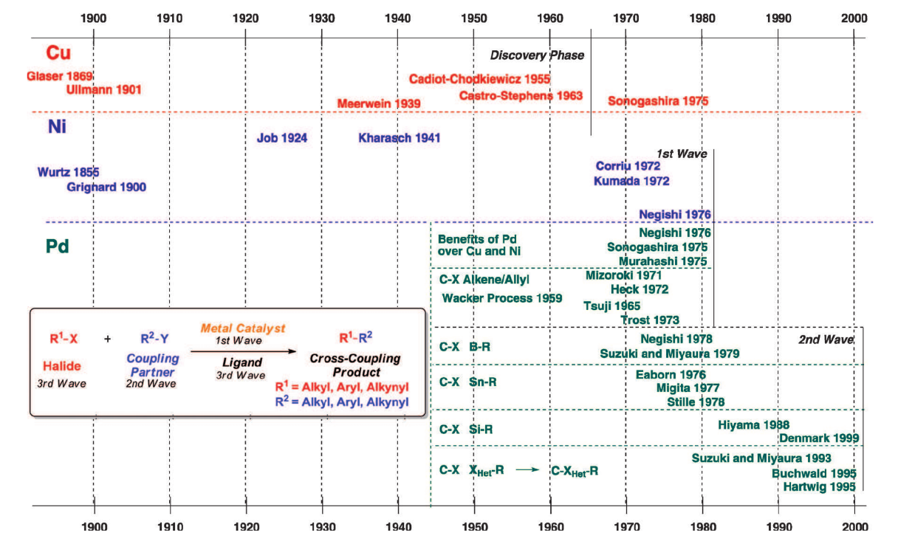
How did it all start?
Johansson Seechurn et al., Angew. Chem. Int. Ed., 2012
Relevance > Examples of Cu Cross Coupling > Mechanism
Notes:
Started with Glaser in 1869 ( 2 R-Alkyne-H =Cu(1)> R-Alkyne-Alkyne-R )
Taking two Terminal alkynes to make a conjugated di-alkyne
First published Cu-based Cross Coupling
2) Then Ullmann 1901
Famous example in terms of early cross coupling
Biphenyl cross-coupling w/ Iodobenzene
Pro => Cu is that it is really good at homocoupling
Pro => Pd is expensive catalyst
Pro => Don’t need to auxillary agents (B(OH)2, SnR, …)
Following the Ullmann Reaction
The next big thing came the Stephens-Castro Coupling
Basically the Sonograshira Reaction w/out Pd
Brief run through Pd transition w/ Murahashi 1975 paper of vinylpalladium compounds
Cu catalysts are commonly stoichiometric thus have died down especially with high Temperature used to produce the components
Lost of optimization with large phenathroline ligands sets to stabilize the Cu intermediate state to p\improve conditions but the effoets are done since Cu only needs the single componenets to do homo-coupling
Cheap AF
- CuI (1kg -> $515)
- Pd(PPh3)4 (25G -> $570)

Slide 4
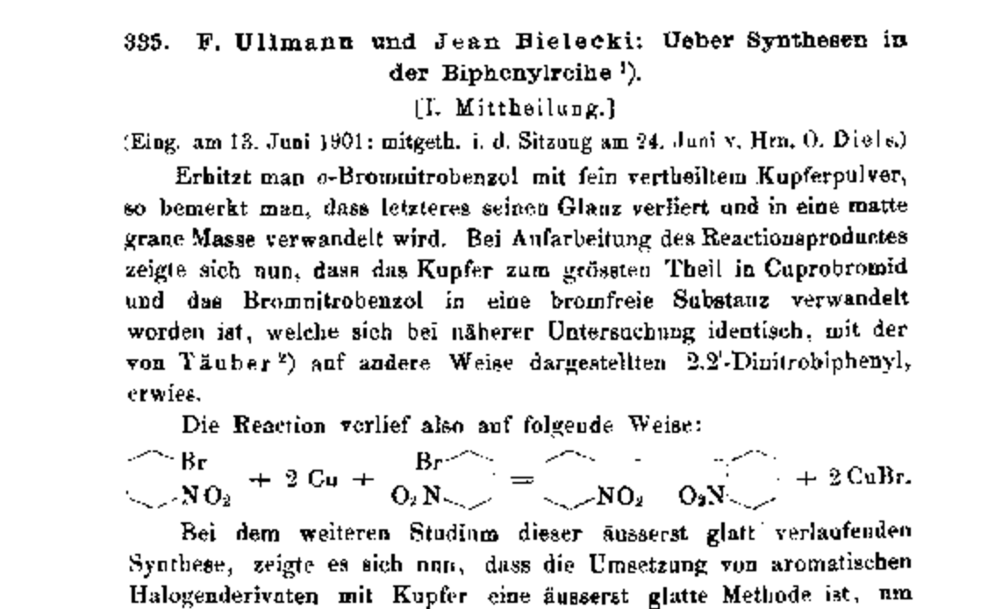
Ullman Reaction
Relevance > Examples of Cu Cross Coupling > Mechanism
Notes:
Initial efforts to do cross-coupling to produce Biphenyl
Make note about Pd catalysts need Aryl borate to form Biphenyl whereas CuI only need Iodobenzene

Slide 5
Ullmann Reaction
CuI
20min @ 220ºC
2
Relevance > Examples of Cu Cross Coupling > Mechanism
Notes:
Note the High Temperatures used for this reaction and write out the mechanism on the board….

Slide 6
Ullmann Catalytic Cycle
Reductive
Elimination
Oxidative Addition
Relevance > Examples of Cu Cross Coupling > Mechanism

Slide 7
Stephens-Castro Reaction
Pyridine, N₂
10hrs @ 120ºC
Relevance > Examples of Cu Cross Coupling > Mechanism
Notes:
Stoichiometric formation of phen-yne compounds
Pyridine needed to H abstract

Slide 8
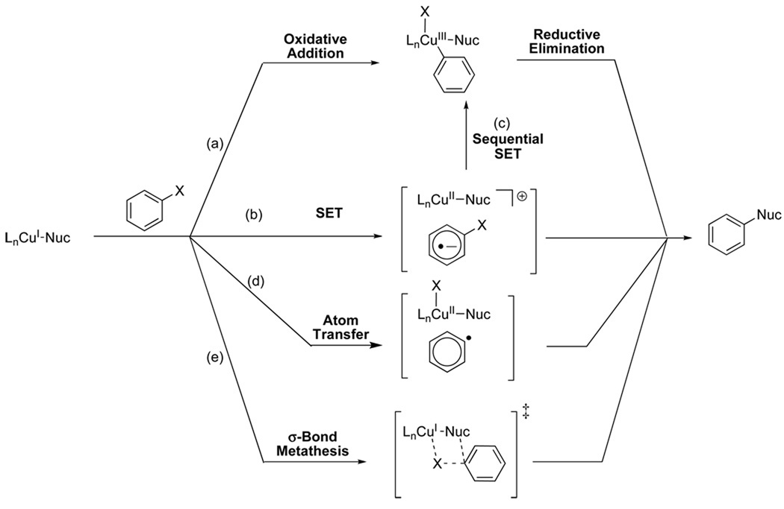
How does the Reaction Work?
ie. Nuc = OMe
Go, J., Liu, P., Houk, KN., Buchwald, SL., J. Am. Chem. Soc., 2010
Relevance > Examples of Cu Cross Coupling > Mechanism
Notes:
Popular Literature uses Oxidative Addition and Reductive Elimination as the standard process to facilitate this reaction
Cu(III) Complexes are unstable therefore not OA and RE
So logically Sigma-Bond metathesis…upon theoretical calculations -> SET and AT favoured

Slide 9
Case 1) Electron Donating Ligand
ie. EDG =
+
+
+
+
+
Relevance > Examples of Cu Cross Coupling > Mechanism

Slide 10
Case II) Electron Withdrawing Ligand
ie. EWG =
+
+
Relevance > Examples of Cu Cross Coupling > Mechanism

Slide 11
Questions?

